Slide 1



Covid_19_Cases_Group3-2
View in Power BI
Raquel Solis, Ilona Laky, Omar Tanimu, Sophia Kapama
Last data refresh:
11/19/2020 8:50:35 PM US Mountain Standard Time
Downloaded at:
11/19/2020 8:53:49 PM US Mountain Standard Time

Slide 2
Context
Our group has been tasked by the Department of Health and Human Services to provide data-driven guidelines for health policies during this pandemic. The primary concerns are:
Which locations are the most at risk?
Does the number of cases appear to be on the rise or on the mend?
This project is focused on analyzing data regarding the spread of Covid-19. The data has been gathered from:
BigQuery Public Datasets Program

Slide 3
In conclusion...
Based on the given data it appears that cases are unfortunately still on the rise and are greatly affecting major cities which have had confirmed cases.
Due to this information we recommend proceeding with the utmost caution as the pandemic is clearly still getting worse, not better.

Slide 4
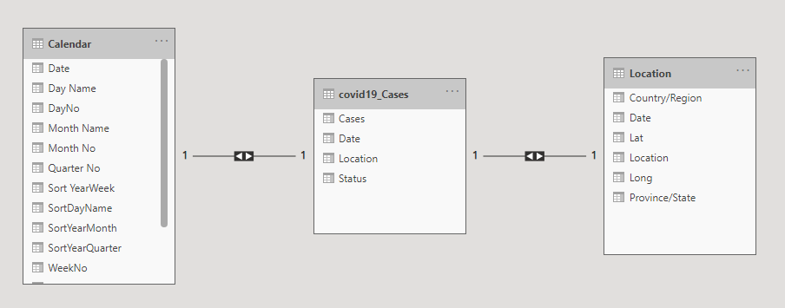
All Tables
Notes:
We chose to manipulate data regarding the current COVID-19 pandemic. Our main fields are calendar, covid19_Cases, and location, all which have their own subfields.

Slide 5
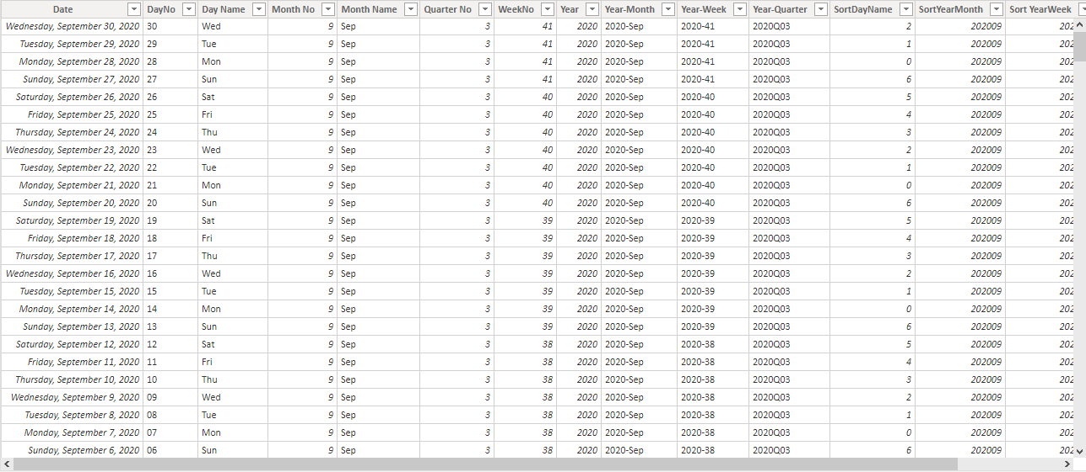
Calendar
Notes:
Field: Calendar
Subfields: Date, DayNo, Day Name, Month No, Month Name, Quarter No, WeekNo, Year, Year-Month, Year-Week, Year-Quarter, SortDayName, SortYearMonth, SortYearWeek

Slide 6
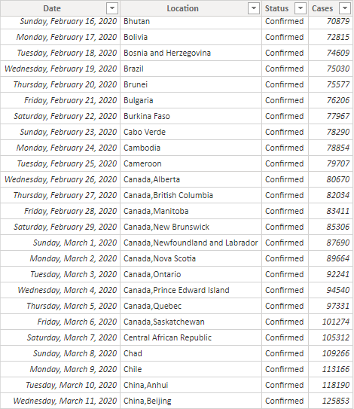
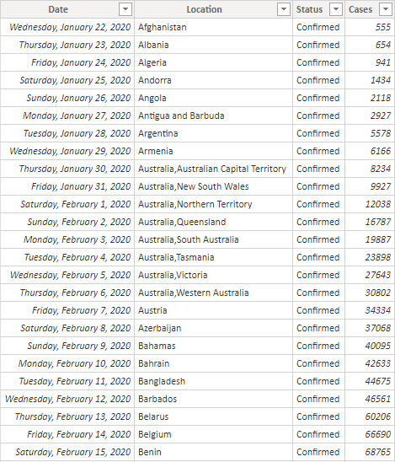
COVID-19 Cases
Notes:
Field: COVID-19 Cases
Subfields: Date, Location, Status, Cases

Slide 7
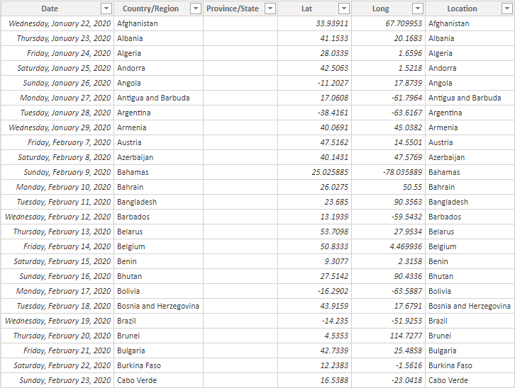
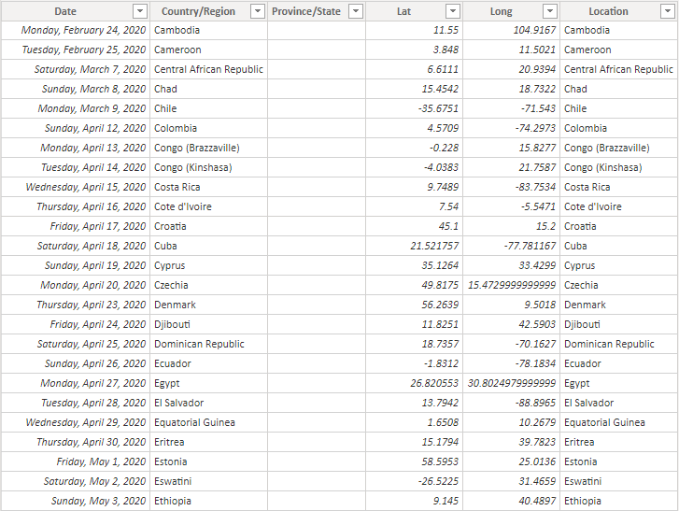
Location
Notes:
Field: Location
Subfields: Date, Country/Region, Lat, Long, Location

Slide 8
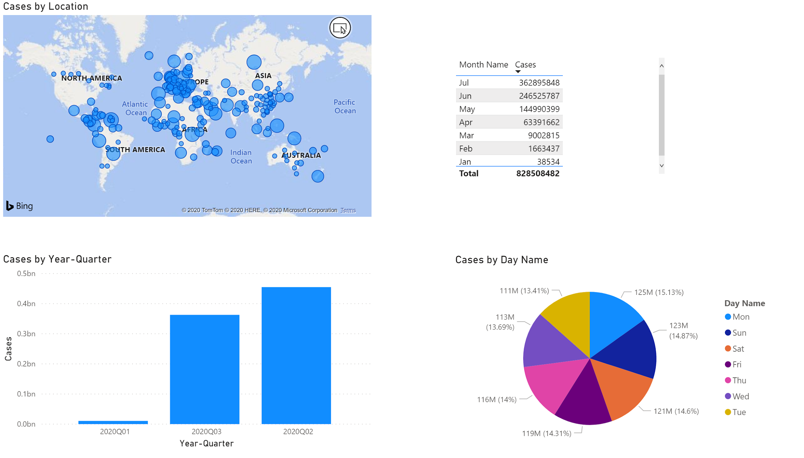
Notes:
Here we have the four visualizations that have been created from our data. Cases by location map shows a high concentration of cases in Europe and Southeastern Asia. The total cases by month table shows that July has had the largest number of cases with a total of 362895848, while June had the second largest. Cases by year-quarter vertical bar chart shows the dramatic differences in the quarters, with quarter two having the most cases. The cases by day name pie chart shows each day is fairly equal, but Monday has had the largest number of cases with 125M.

